Slide 1
PERFORMING ARTS
DANCE

Slide 2
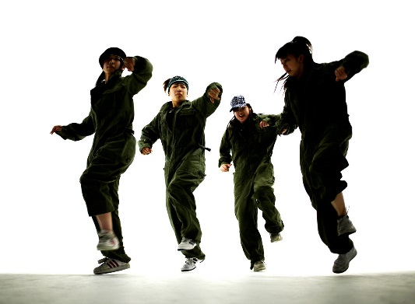
Learning Objective
To be able to:
Participate effectively throughout the warm up showing focus, energy and determination.
Continue to learn the street dance routine demonstrating key features of street dance-
isolations,
Dynamics,
100% energy
Accurate movement memory!

Slide 3
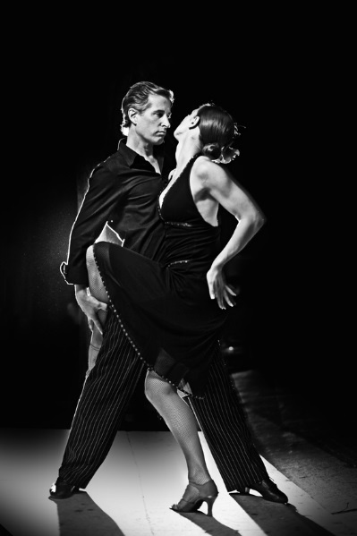
Success Criteria
Step 3
Can focus in the warm and identify some pulse raisers.
Can reproduce the taught routine with a few errors.
Step 4
Will focus and put effort in throughout the lessons and be able to identify the 3 sections of the warm up.
Will perform the routine with energy and focus.
Step 5.
Will concentrate and perform to the best of their ability throughout the lesson and work hard to warm up effectively.
Will perform with focus and accuracy of movement and always be keen to improve.
Step 6
Will be a role model to the group, work hard at all times and be proactive in asking and answering questions.
Will take a leadership role when rehearsing and help others to perform the routine.

Slide 4

FIZZ BUZZ
YOU HAVE TO JUMP FOR FIZZ AND SPIN FOR BUZZ
All pupils stand in a circle in the room. Go round the circle counting from one upwards, in number order. If a pupil says a multiple of 3 they JUMP and if they say a multiple of 5 they say SPIN. If they say a multiple of 3 and its also a multiple of 5 then they say JUMP AND SPIN at the same time.
Skills Required
Listening to others
Knowing your timetables
Thinking quickly
Concentrating
BE AWARE OF YOUR SPACE!

Slide 5
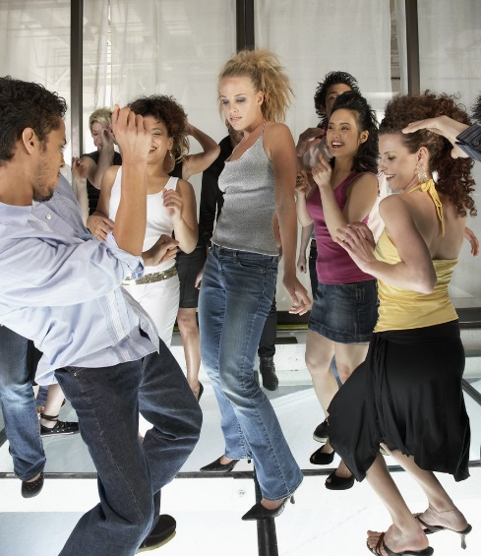
KEY WORDS
ACTION-WHAT can you give examples?
DYNAMIC-HOW
SPACE-WHERE
RELATIONSHIPS-WHO
RHYTHM-TIMING
FOCUS
NEW WORD- ISOLATION

Slide 6
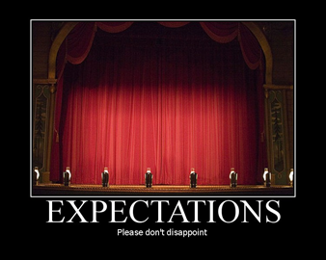

EXPECTATIONS
BE RESPECTFUL OF OTHERS IN THE CLASS.
TRY YOUR HARDEST AT ALL TIMES.
LISTEN TO FEEDBACK AND USE THIS CONSTRUCTIVELY TO IMPROVE YOUR PERFORMANCE.
LISTEN TO THE TEACHER AT ALL TIMES.
BE ABLE TO WORK AS A GROUP AND INDEPENDENTLY.
BE CREATIVE.
USE THE STAGE EFFECTIVELY.
LISTEN TO YOUR PEERS IDEAS

Slide 7

WARM UP
RECAP 5min tasks
A warm up has 3 sections-
Pulse raiser,
Co-ordination
stretch.
In groups of 4 create 3 pulse raisers, 3 co-ordination exercises, 3 stretches (make sure you know which part you need to lead)

Slide 8
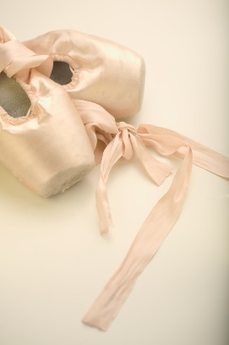
5 BASIC ACTIONS
The 5 basic actions are
Jump
Hop
Travel
Stillness/gesture
Turn/rotate

Slide 9
STREET DANCE
In the routine you now need to focus on your execution of movements. What does this mean? Discuss
REMEMBER TO; stay in time, carry
On if you go wrong!

Slide 10

EXTENSION TASK PERFORMANCE!
In 2 groups you will now perform the routine to each other.
LEVEL CHECK!
DON’T worry if you go wrong- carry on!

Slide 11
PLENARY
What have you learnt today?
Set yourself a target to improve and put it on the board

